Slide 1





INNOVATIVE HARDWARE MODEL MAKING COMPETITION

Slide 2
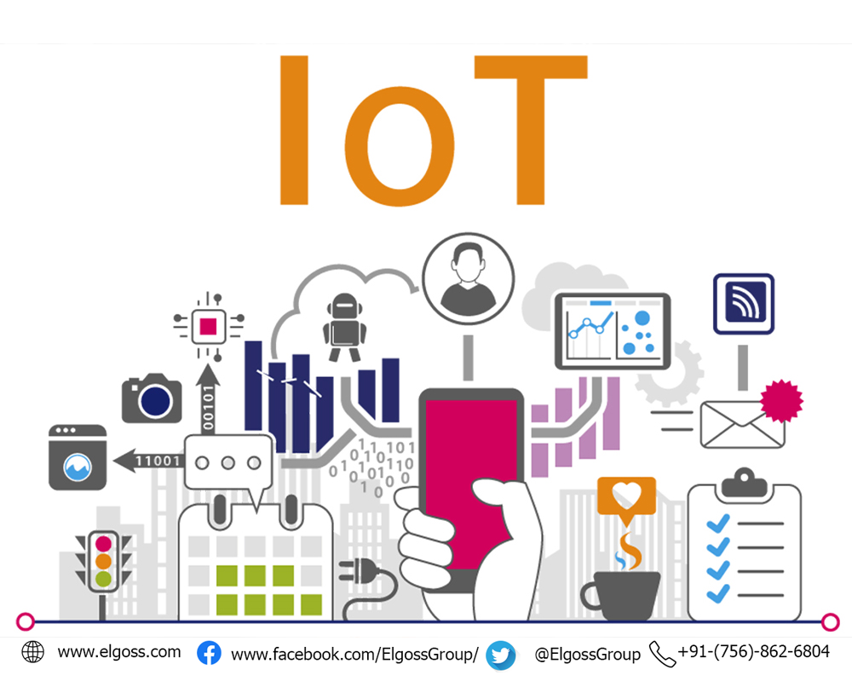
IOT BASED ADAPTIVE INDUSTRIALIZED SECURITY SYSTEM
PRESENTED BY:
PARTHA SARATHI PAL
SWARNALI MUKHERJEE
SUVAM SADHU
SUNAINA KUMARI HELLA
SUBHRAJIT MUKHERJEE

Slide 3
PROBLEM
Industrial facilities often house valuable assets, equipment, and confidential information, making them prime targets for theft, espionage, or sabotage. Inadequate security measures can lead to significant financial losses, operational disruptions, and reputational damage. Industrial plants are also susceptible to physical safety risks, such as fires, explosions, or chemical releases, which can cause severe injuries, fatalities, and property damage. Without proper safeguards and emergency response plans, these incidents can quickly escalate and result in catastrophic consequences.

Slide 4
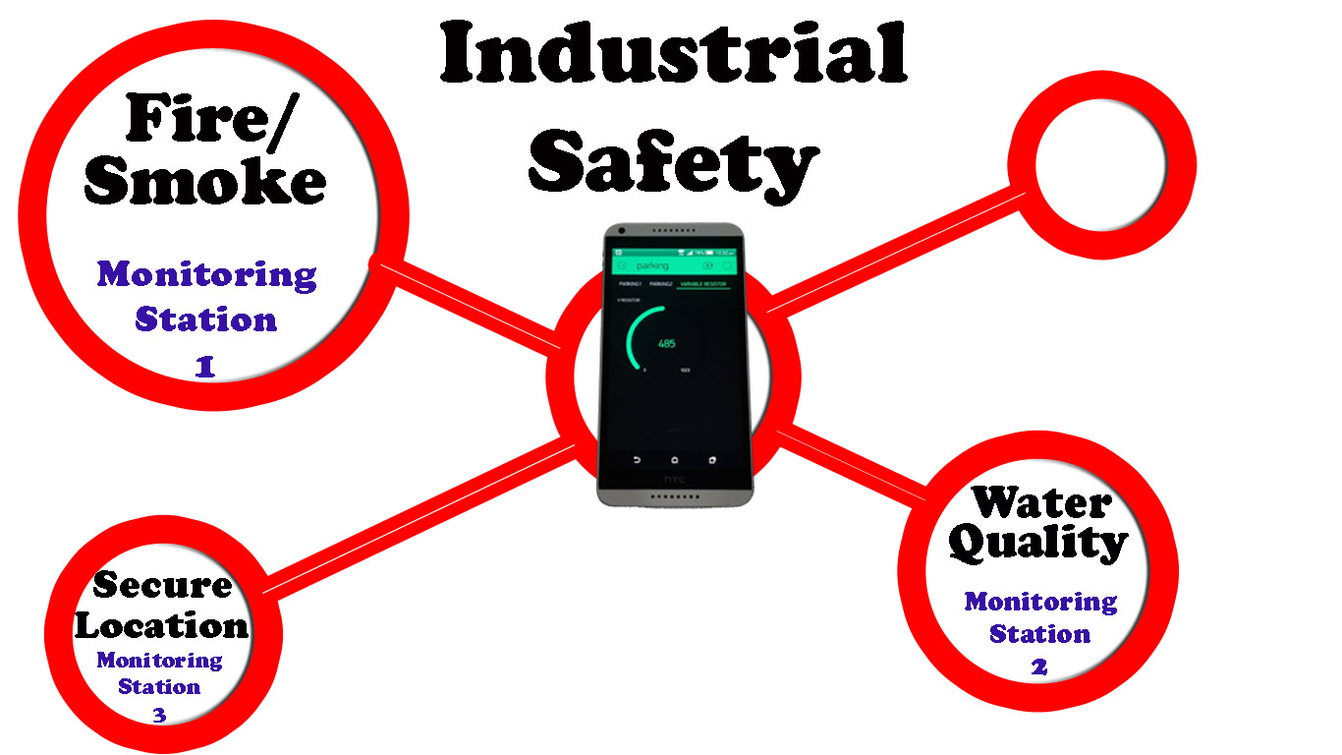
OBJECTIVE
The main objective of our Advanced Security System project is to protect industry appliances, peoples & get current access of data through Blynk, Email, & other web applications also. Whenever some emergency arises at that instant we'll be notified & It allows us to get remote access so that we can take immediate actions as per necessity.

Slide 5
Component Used:-
ESP8266 MICROCONTROLLER
DHT11 SENSOR
ULTRASONIC SENSOR
MQ5 SENSOR
IR MODULE
BUZZER
TWO CHANNEL 5V RELAY
BREADBOARD
JUMPER WIRES

Slide 6
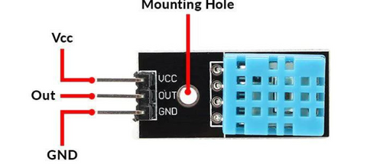
DHT11 Sensor
The DHT11 is a commonly used Temperature and humidity sensor for prototypes monitoring the ambient temperature and humidity of a given area

Slide 7
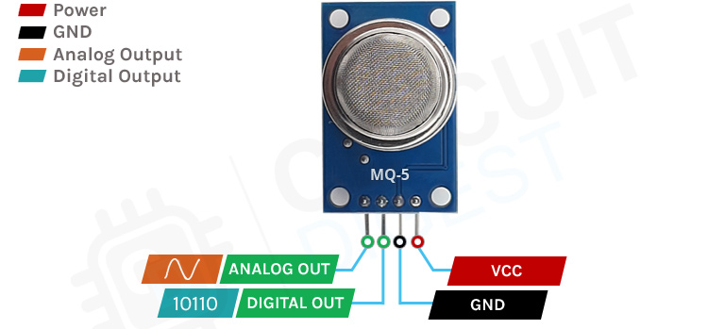
MQ-5 Sensor
The Grove - Gas Sensor(MQ5) module is useful for gas leakage detection (in home and industry). It is suitable for detecting H2, LPG, CH4, CO, Alcohol. Due to its high sensitivity and fast response time, measurements can be taken as soon as possible.

Slide 8
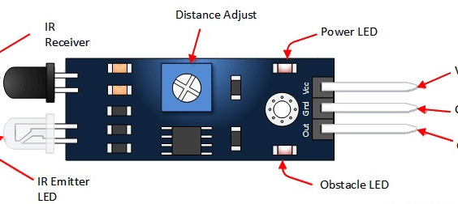
IR Module
The IR Sensor Module or infrared (IR) sensor is a basic and most popular sensor in electronics. It is used in wireless technology like remote controlling functions and detection of surrounding objects/ obstacles

Slide 9
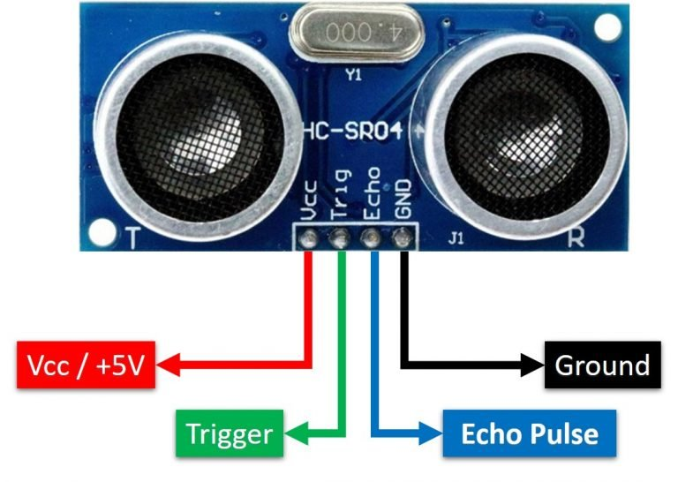
Ultrasonic sensor
Ultrasonic level sensors are commonly used to measure distance or level, volume, and are used in flow monitoring.

Slide 10
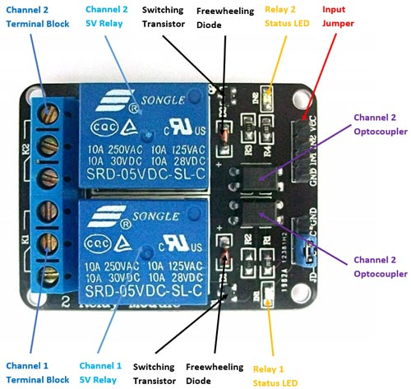
2 -Channel 5V Relay module
A power relay module is an electrical switch that is operated by an electromagnet. The electromagnet is activated by a separate low-power signal from a micro controller. When activated, the electromagnet pulls to either open or close an electrical circuit.

Slide 11


Services Used:-
Blynk is an IoT platform for iOS or Android smartphones that is used to control Arduino, Raspberry Pi and NodeMCU via the Internet. This application is used to create a graphical interface or human machine interface (HMI) by compiling and providing the appropriate address on the available widgets.
IFTTT stands for “If This Then That.” It's a free web service that helps users automate web-based tasks and improve productivity. IFTTT connects various developers' devices, services and apps to create “applets” that perform automations.

Slide 12


Firebase
Google Sheet
With Google Sheets, we can create and edit spreadsheets directly in your web browser—no special software is required. Multiple people can work simultaneously, We can see people's changes as they make, and every change is saved automatically.
Firebase Hosting works out-of-the-box with Firebase services, including Cloud Functions, Authentication, Realtime Database, Cloud Firestore, and Cloud Messaging

Slide 13
Future Aspects:-
We’ll try to implement this in more advanced way by using esp32 cam module through which we’ll be aware of introducer’s details & will try to take enhancement of cloud services.

Slide 14
Thank You

